Slide 1
ML Visuals
By dair.ai
https://github.com/dair-ai/ml-visuals
Notes:
ML Visuals is a new collaborative effort to help the machine learning community in improving science communication by using more professional, compelling and adequate visuals and figures. You are free to use the visuals in your presentations or blog posts. You don’t need to ask permission to use any of the visuals but it will be nice if you can provide credit to the designer/author (author information found in the slide notes).
This is a project made by the dair.ai community and maintained in this GitHub repo. Our community members will continue to add more common figures and basic elements in upcoming versions. Think of this as free and open artefacts and templates which you can freely and easily download, copy, distribute, reuse and customize to your own needs. I am maintaining this set of slides on a bi-weekly basis where I will regularly organize and keep the slides clean from spam or unfinished content.
IMPORTANT NOTE: Please don’t request editing permission if you do not plan to add anything to the slides. If you want to edit the slides for your own purposes, just make a copy of the slides.
Contributing: To add your own custom figures, simply add a new slide and reuse any of the basic visual components (remember to request edit permissions). We encourage authors/designers to add their visuals here and allow others to reuse them. Make sure to include your author information (in the notes section of the slide) so that others can provide the proper credit if they use the visuals elsewhere (e.g. blog/presentations). Add your name and email just in case someone has any questions related to the figures you added. Also, provide a short description of your visual to help the user understand what it is about and how they can use it. If you need "Edit" permission, just click on the "request edit access" option under the "view only" toolbar above or send me an email at ellfae@gmail.com. If you have editing rights, please make sure not to delete any of the work that other authors have added. You can try to improve it by creating a new slide and adding that improved version (that’s actually encouraged).
Downloading a figure from any of the slides is easy. Just click on File→Download→(choose your format).
If you need help with customizing a figure or have an idea of something that could be valuable to others, we can help. Just open an issue here and we will do our best to come up with the visual. Thanks.
Feel free to ask us anything related to this project in our Slack group.

Slide 2
Basic components
Notes:
Note:
Basic components go here.

Slide 3
Notes:
Note:
This is a simple round rectangle that can represent some process, operation, or transformation
Author: Elvis Saravia (ellfae@gmail.com)

Slide 4
Notes:
Note:
This can be used to represent a vector. If you want to edit the distance between each element, you can “ungroup” the shapes and then modify the distance between the individual lines.
Author: Elvis Saravia (ellfae@gmail.com)

Slide 5
Notes:
Symbolizing an embedding

Slide 6
Notes:
Note:
Can represent a neuron or some arbitrary operation
Author: Elvis Saravia (ellfae@gmail.com)

Slide 7




Softmax
Convolve
Sharpen
Notes:
Note:
These visuals could represent transformations (left) or operations (right)
The visuals on the right use the Math Equations Add on for Google Slides.
If you click on the equation you are able to modify it by:
Selecting Add Ons → Math Equations → Menu
While the equation is selected, click “Connect to Equation” on the “Math Equations UI”
Then change the properties like color, size, etc.
Author: Elvis Saravia (ellfae@gmail.com)

Slide 8




Softmax
Convolve
Sharpen
Notes:
Note:
These visuals could represent transformations (left) or operations (right)
The visuals on the right use the Math Equations Add on for Google Slides.
If you click on the equation you are able to modify it by:
Selecting Add Ons → Math Equations → Menu
While the equation is selected, click “Connect to Equation” on the “Math Equations UI”
Then change the properties like color, size, etc.
Author: Elvis Saravia (ellfae@gmail.com)
Log:
Added a dark theme version of the previous slide

Slide 9
Notes:
Note:
These visuals can represent a multi-directional array (3D) input, tensor, etc.
Author: Elvis Saravia (ellfae@gmail.com)

Slide 10
Architectures
Notes:
Note:
You can add abstract backgrounds here

Slide 11
Pain Levels | Trials
Level-1 | 500
Level-2 | 400
Level-3 | 200
Level-3 | 100

Slide 12
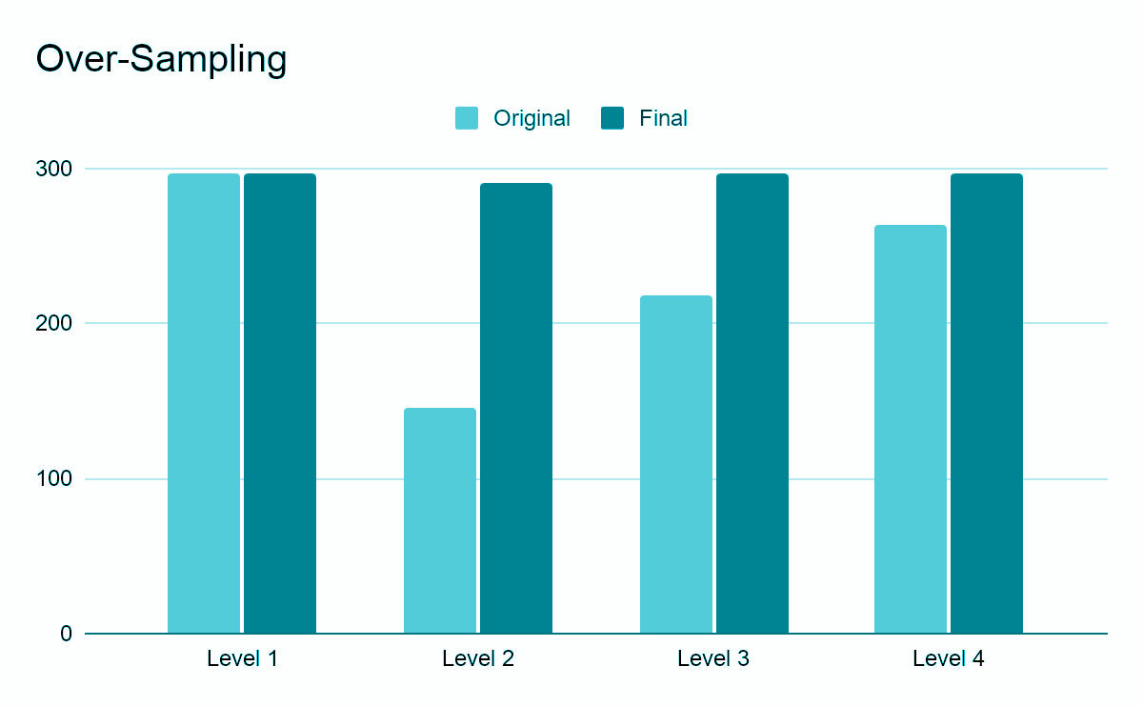

Slide 13
SM
FC
L
L
L
L
L
L
L
L
L
L
C
C
C
C
C
C
C
C
C
C

Slide 14
SM
FC
Conv
C
C
C
C
C
C
C
C
C
C

Slide 15
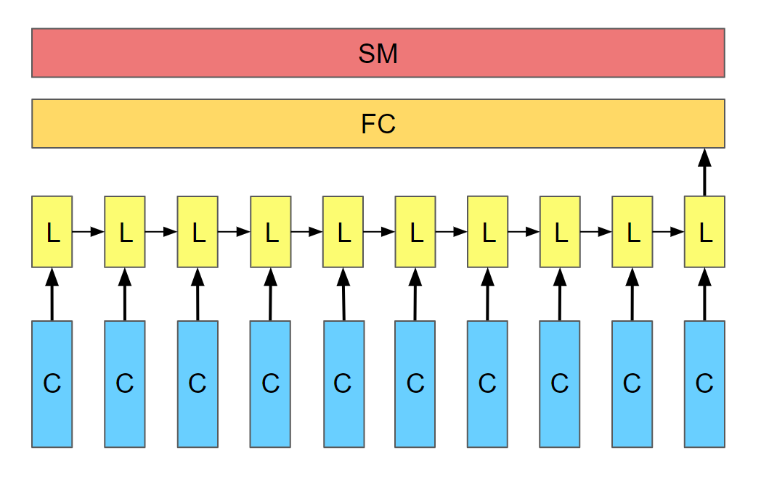
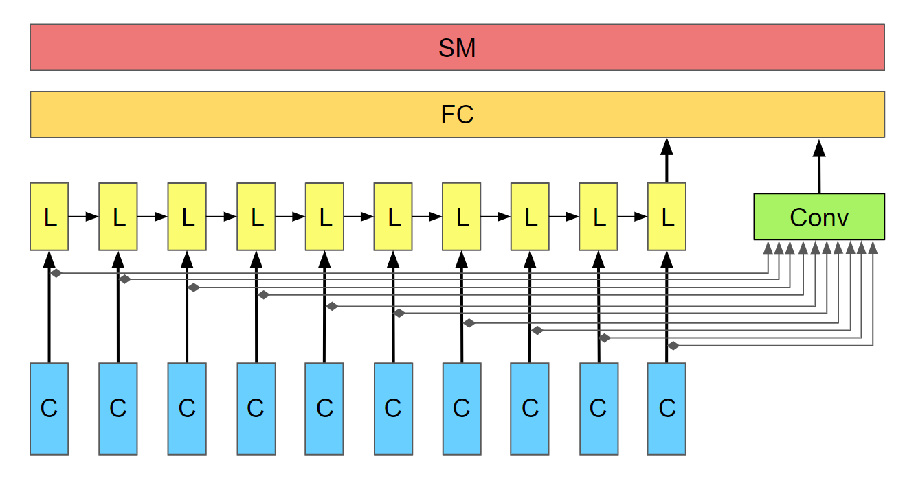
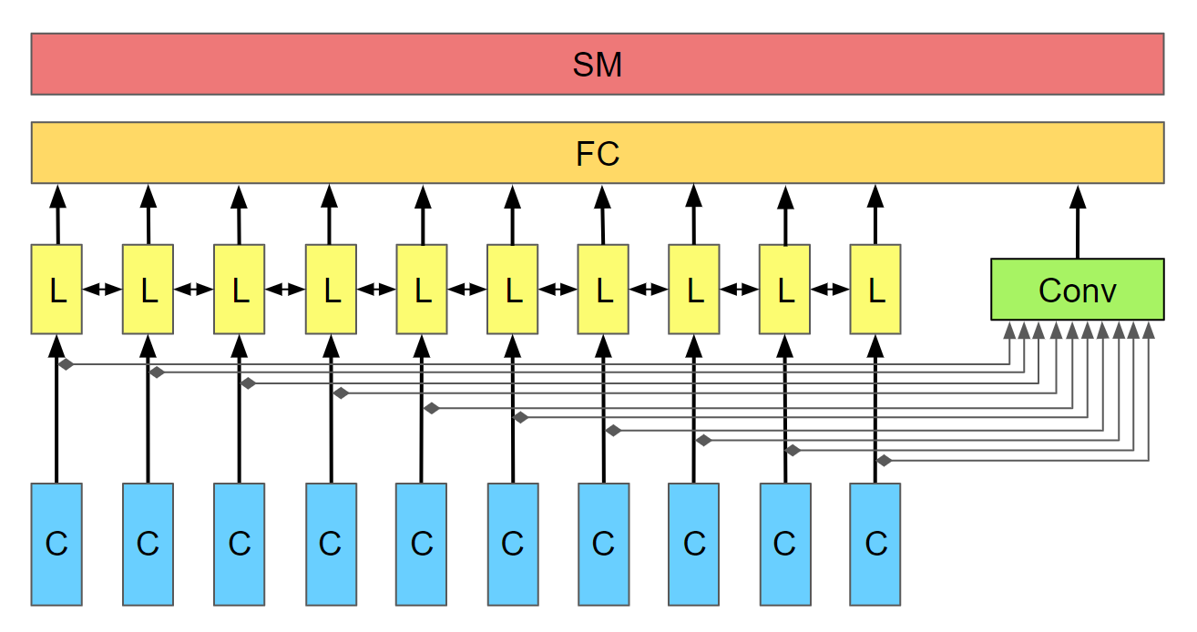
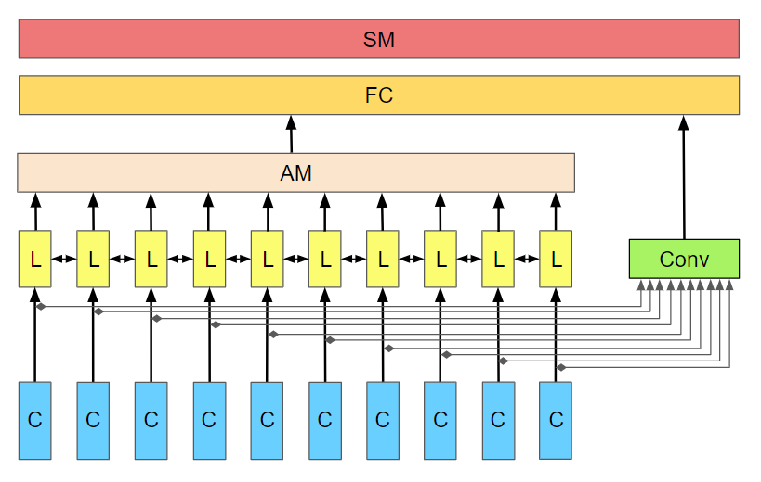
A) LSTM
B) Mixed LSTM / 1D Conv
C) Mixed BiLSTM / 1D Conv
D) Mixed Att-BiLSTM / 1D Conv

Slide 16
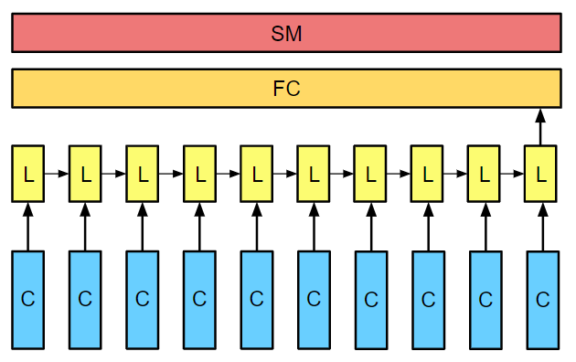
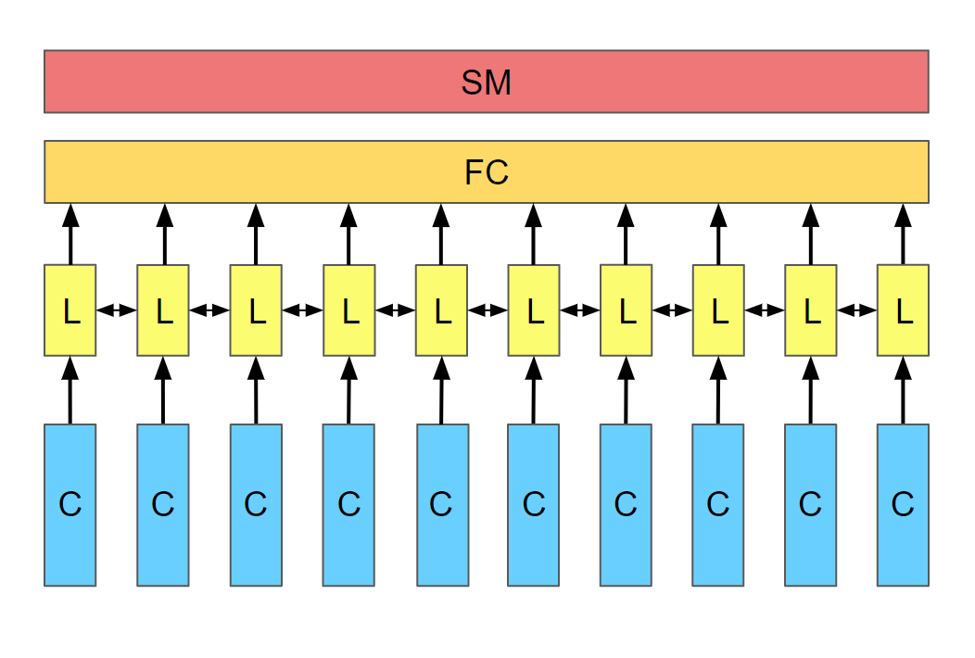
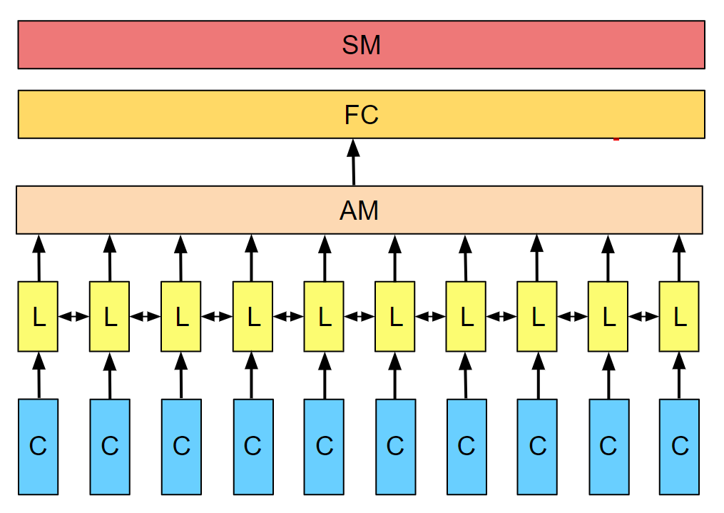
A) LSTM
B) LSTM / 1D-Conv
C) BiLSTM
D) Att-BiLSTM

Slide 17
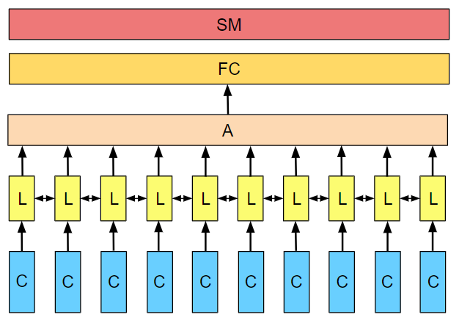
A) LSTM
B) LSTM / 1D-Conv
C) BiLSTM
D) Att-BiLSTM

Slide 18
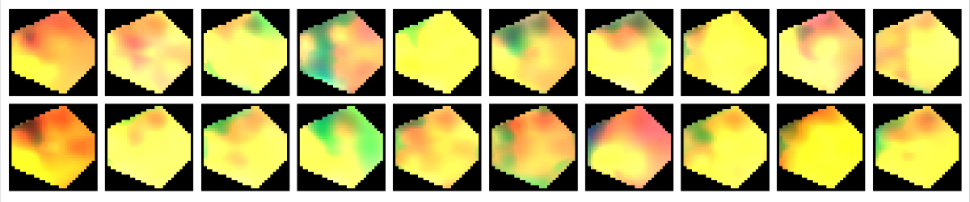
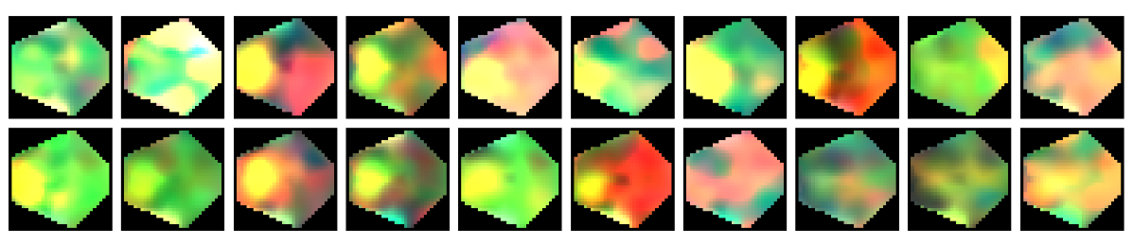
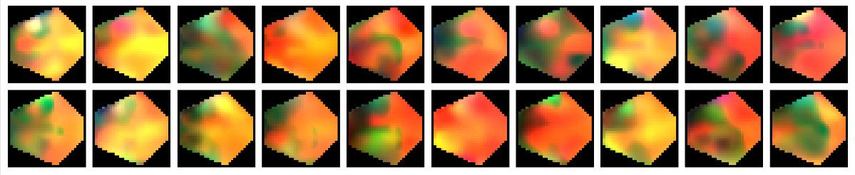
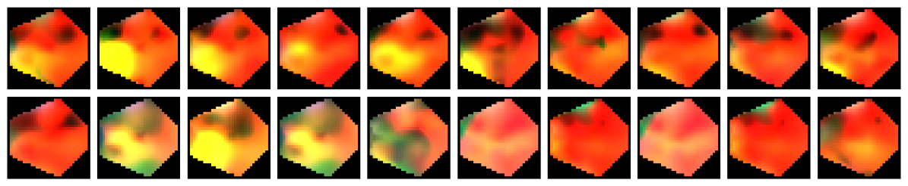
Sample1
Level 1
Sample2
Sample1
Level 2
Sample2
Sample1
Level 3
Sample2
Sample1
Level 4
Sample2
Frame1
Frame2
Frame3
Frame4
Frame5
Frame6
Frame7
Frame8
Frame9
Frame10

Slide 19
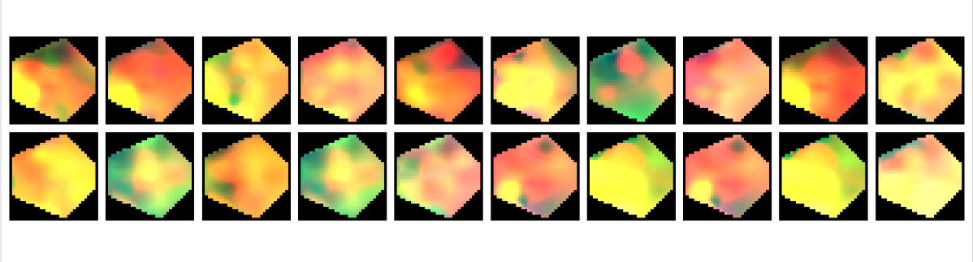
S7
S8
Frame1
Frame2
Frame3
Frame4
Frame5
Frame6
Frame7
Frame8
Frame9
Frame10

Slide 20
S7
S8
Frame1
Frame2
Frame3
Frame4
Frame5
Frame6
Frame7
Frame8
Frame9
Frame10
Sample1
Level 1
Sample2
Sample1
Level 2
Sample2
Sample1
Level 3
Sample2
Sample1
Level 4
Sample2
Frame1
Frame2
Frame3
Frame4
Frame5
Frame6
Frame7
Frame8
Frame9
Frame10

Slide 21
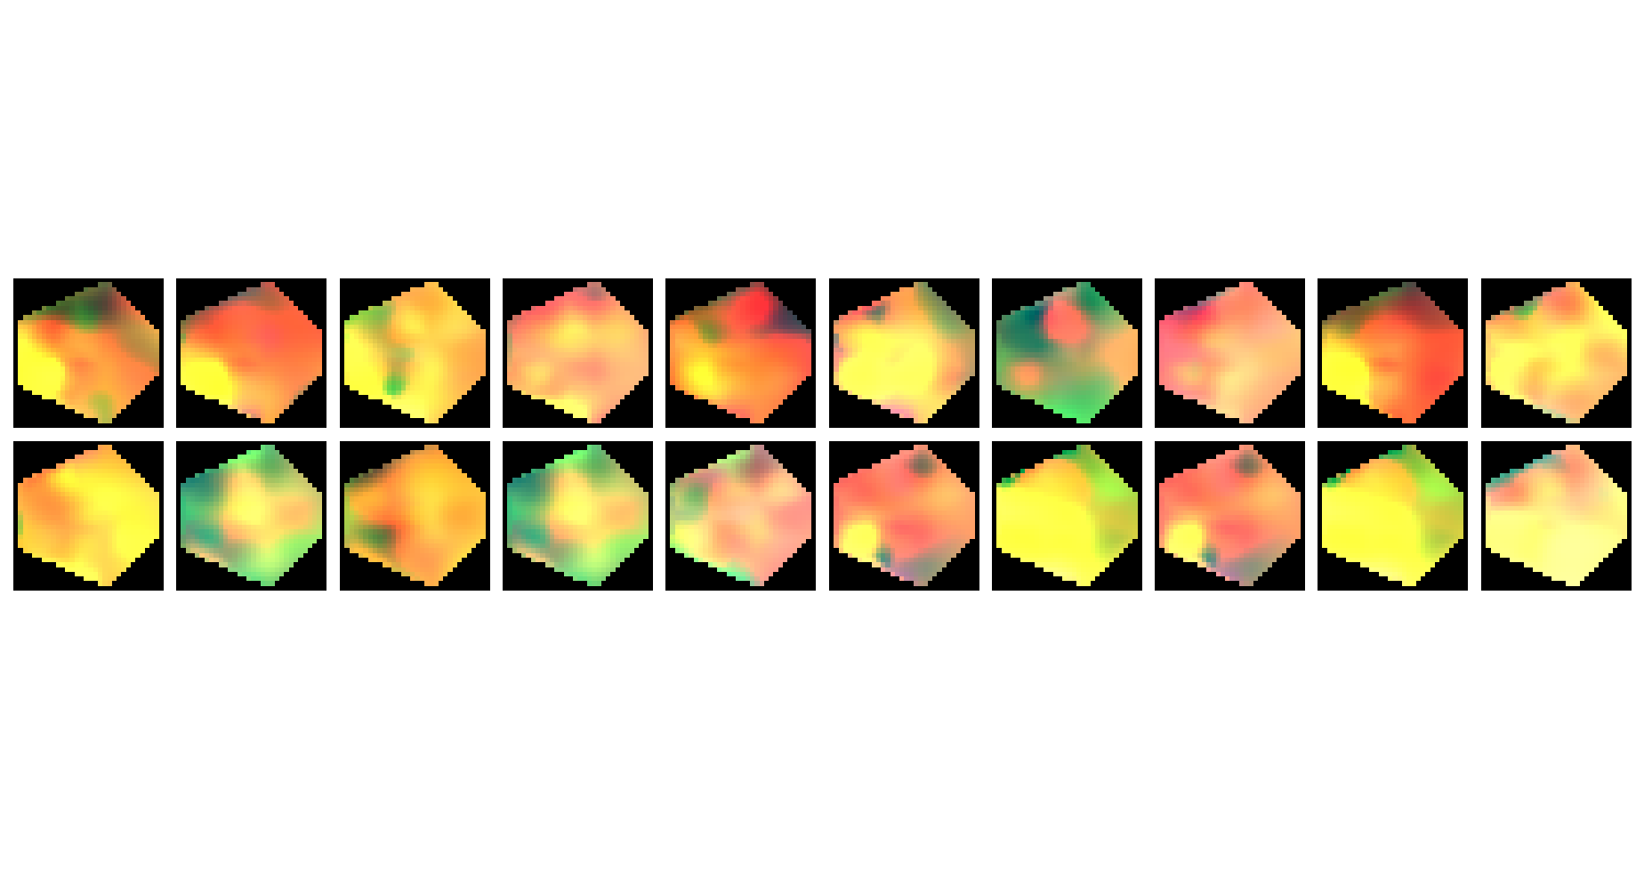

Slide 22
SM
FC
AM
L
L
L
L
L
L
L
L
L
L
Conv
C
C
C
C
C
C
C
C
C
C

Slide 23
SM
FC
Attention
L
L
L
L
L
L
L
L
L
L
C
C
C
C
C
C
C
C
C
C

Slide 24
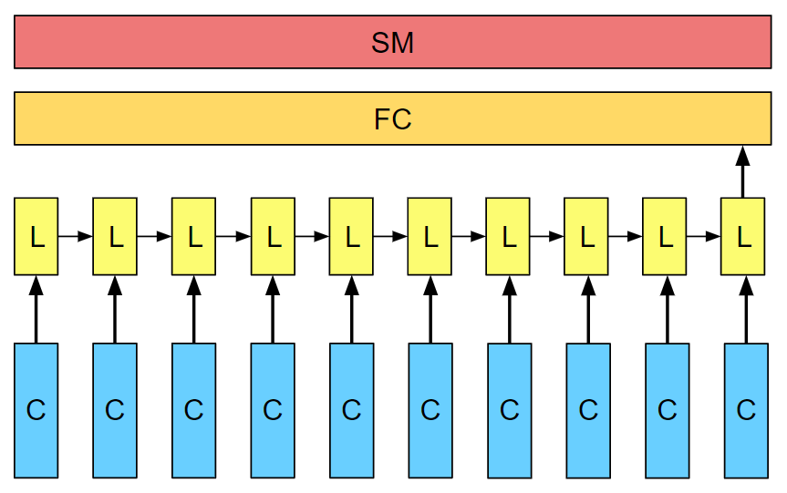
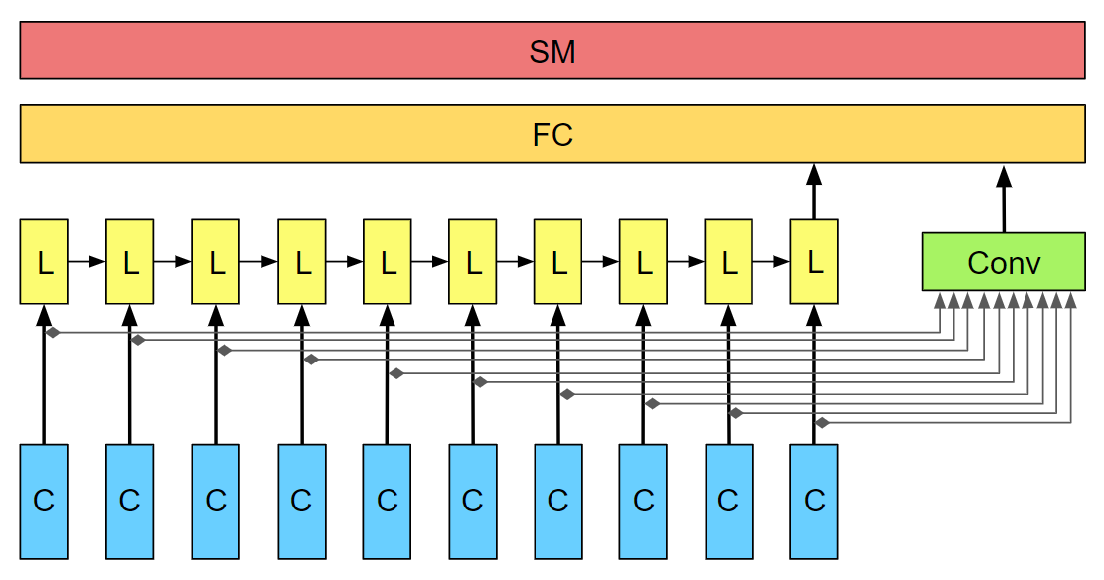
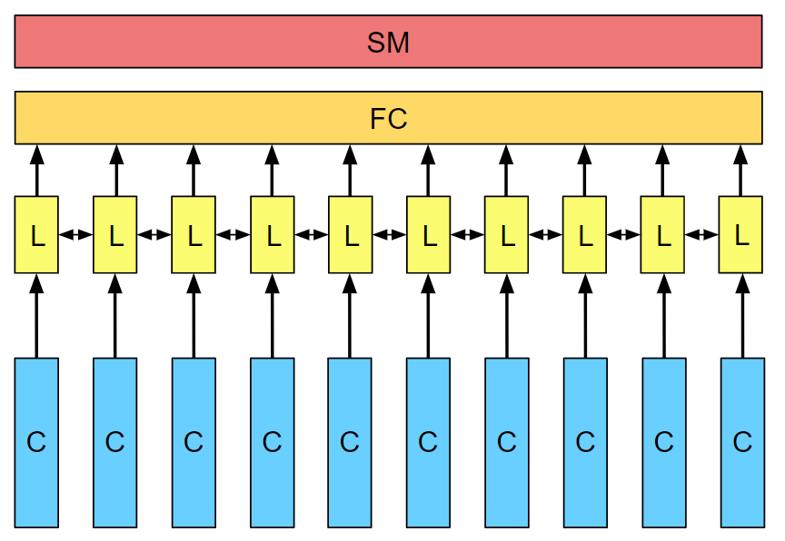
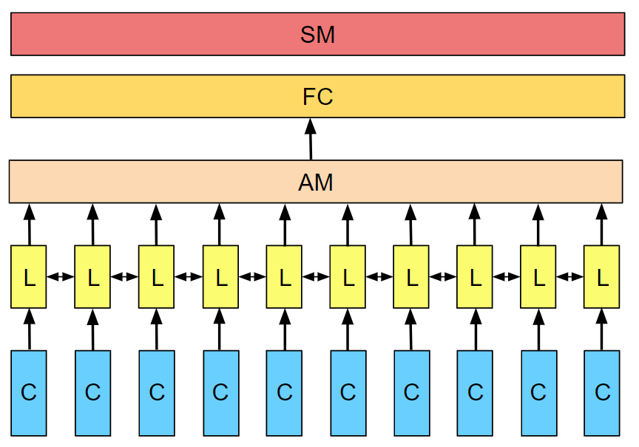
A) CNN-LSTM
B) CNN-LSTM/1D-Conv
C) CNN-BiLSTM
D) CNN-ANN-BiLSTM (ARCNN)

Slide 25
A) LSTM
B) LSTM / 1D-Conv
C) BiLSTM
D) Att-BiLSTM

Slide 26
SM
FC
L
L
L
L
L
L
L
L
L
L
C
C
C
C
C
C
C
C
C
C

Slide 27
SM
FC
L
L
L
L
L
L
L
L
L
L
Conv
C
C
C
C
C
C
C
C
C
C

Slide 28
SM
FC
AM
L
L
L
L
L
L
L
L
L
L
L
L
L
L
L
L
L
L
L
L
Conv
C
C
C
C
C
C
C
C
C
C

Slide 29
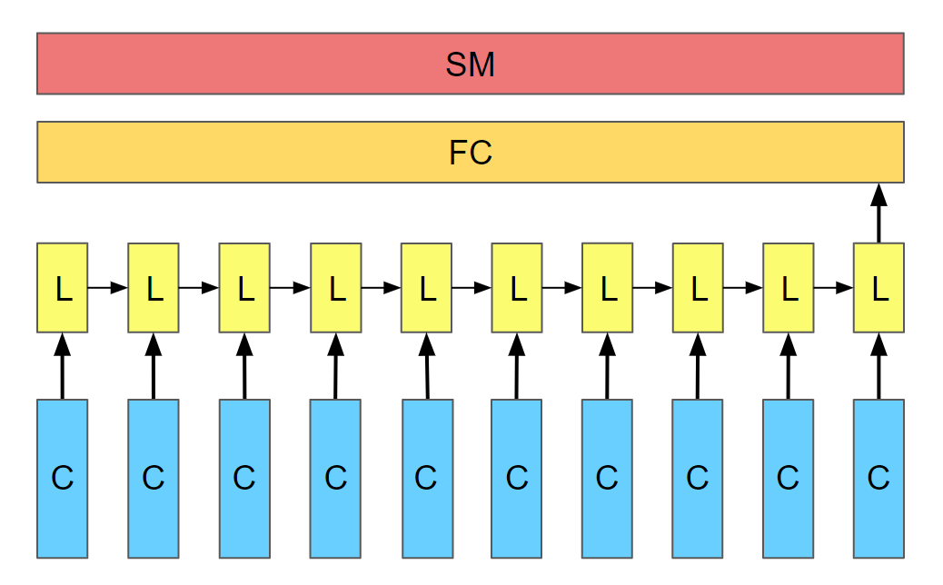
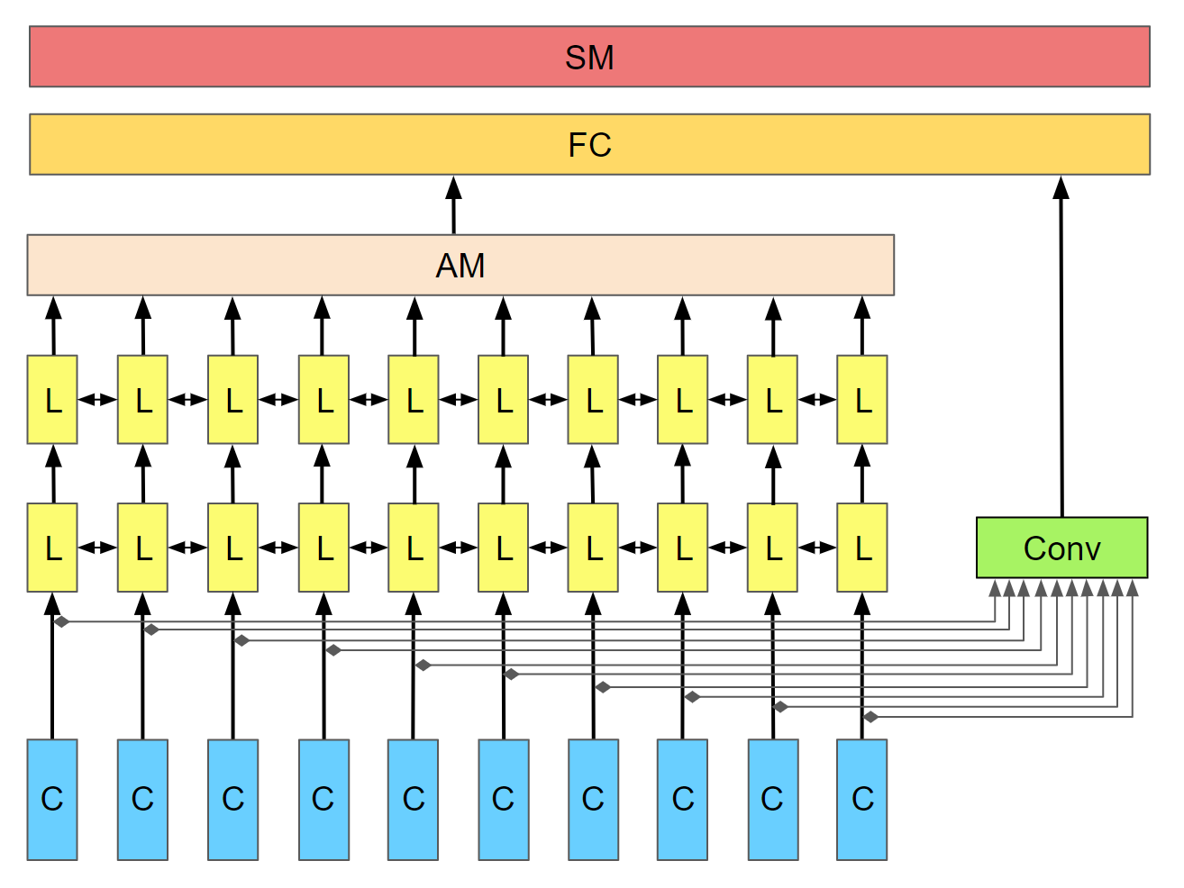

Slide 30
SM
FC
L
L
L
L
L
L
L
L
L
L
Conv
C
C
C
C
C
C
C
C
C
C

Slide 31
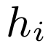
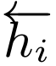
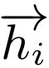
Attention layer
LSTM layer
CNN
layer
C
C
C
C
C
C
C
C
C
C

Slide 32
Attention layer
LSTM layer
CNN
layer
C

Slide 33
Output
Attention layer
LSTM layer
CNN
layer
C
C
C
C
C
C
C
C
C
C

Slide 34
A) LSTM
B) LSTM / 1D Conv
C) BiLSTM / 1DConv
D) Att-BiLSTM / 1D Conv

Slide 35
A) LSTM
B) LSTM / 1D-Conv
C) BiLSTM
D) Att-BiLSTM

Slide 37
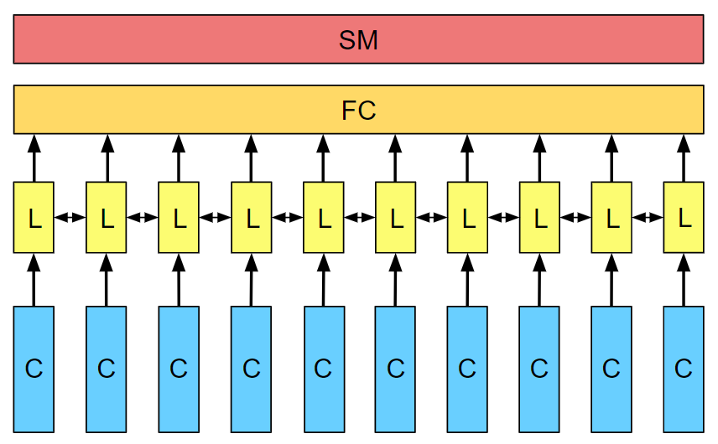

Slide 38
SM
FC
L
L
L
L
L
L
L
L
L
L
C
C
C
C
C
C
C
C
C
C

Slide 39
SM
FC
AM
L
L
L
L
L
L
L
Conv
C
C
C
C
C
C
C

Slide 40
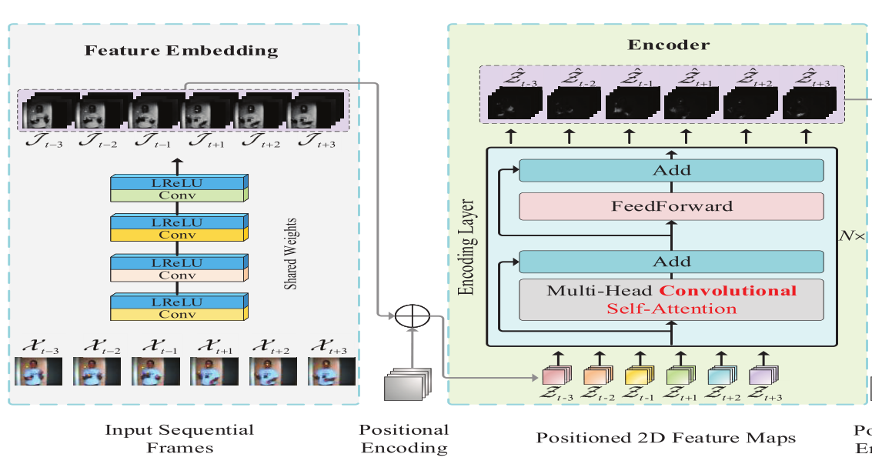
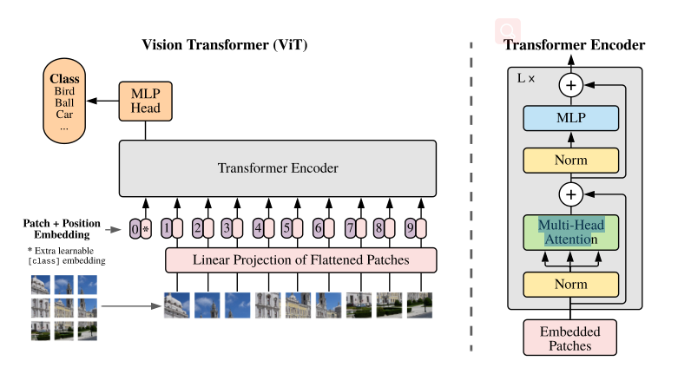

Slide 41
Hidden Layers
Input Layer
a^{[1]}₁
a^{[2]}₁
a^{[3]}₁
Output Layer
a^{[1]}₂
a^{[2]}₂
a^{[3]}₂
a^{[4]}
Ŷ
X
a^{[1]}₃
a^{[2]}₃
a^{[3]}₃
a^{[1]}_{n}
a^{[2]}_{n}
a^{[3]}_{n}
X = A^{[0]}
A^{[1]}
A^{[2]}
A^{[3]}
A^{[4]}
Notes:
Created By @srvmshr
sourav@yahoo.com

Slide 42
Hidden Layers
Input Layer
^{[1}a]₁
a^{[2]}₁
a^{[3]}₁
Output Layer
a^{[1]}₂
a^{[2]}₂
a^{[3]}₂
a^{[4]}
Ŷ
X
a^{[1]}₃
a^{[2]}₃
a^{[3]}₃
a^{[1]}_{n}
a^{[2]}_{n}
a^{[3]}_{n}
X = A^{[0]}
A^{[1]}
A^{[2]}
A^{[3]}
A^{[4]}
Notes:
Created By @srvmshr
sourav@yahoo.com

Slide 43
Hidden Layers
Input Layer
a^{[1]}₁
a^{[2]}₁
a^{[3]}₁
Output Layer
a^{[1]}₂
a^{[2]}₂
a^{[3]}₂
a^{[4]}
Ŷ
X
a^{[1]}₃
a^{[2]}₃
a^{[3]}₃
a^{[1]}_{n}
a^{[2]}_{n}
a^{[3]}_{n}
X = A^{[0]}
A^{[4]}
A^{[1]}
A^{[2]}
A^{[3]}
Notes:
Original by @srvmshr
sourav@yahoo.com
Dark themed version by (Elvis Saravia - ellfae@gmail.com)

Slide 44
CONV operation
MxM
ReLU
+b1
+b1
MxMX2
+b2
+b2
NxNx3
MxM
ReLU
a^{[l-1]}
a^{[l]}
Notes:
Added by @srvmshr
Sourav @ yahoo.com

Slide 45
CONV operation
MxM
ReLU
+b1
+b1
MxMX2
+b2
+b2
NxNx3
MxM
ReLU
Notes:
Added by @srvmshr
Sourav @ yahoo.com

Slide 46
CONV operation
MxM
ReLU
+b1
+b1
MxMX2
+b2
+b2
NxNx3
MxM
ReLU
Notes:
Added by @srvmshr
Sourav @ yahoo.com

Slide 47
Striding in CONV
S=1
S=2
Notes:
Created by @srvmshr
Sourav @ yahoo.com

Slide 48
Notes:
Created by @srvmshr
Sourav @ yahoo.com

Slide 50
Inception Module
MaxPool Same s=1
5x5 Same
3x3 Same
NxNx192
1x1 Same
NxNx192
NxNx128
NxNx32
NxNx64
Notes:
Created by @srvmshr
Sourav @ yahoo.com

Slide 51
Notes:
Note:
1 hidden layer neural network
Author: Elvis Saravia (ellfae@gmail.com)

Slide 52
t-1
t
Retraining w/o expansion
Notes:
Note:
1 hidden layer neural network
Author: Elvis Saravia (ellfae@gmail.com)

Slide 53
No-Retraining w/ expansion
Partial Retraining w/ expansion
Notes:
Note:
1 hidden layer neural network
Author: Elvis Saravia (ellfae@gmail.com)

Slide 54
t-1
t
t-1
t
No-Retraining w/ expansion
Partial Retraining w/ expansion
Notes:
Note:
1 hidden layer neural network
Author: Elvis Saravia (ellfae@gmail.com)

Slide 55
t-1
t
t-1
t
t-1
t
Retraining expansion
No-Retraining expansion
Partial Retraining expansion
Notes:
Note:
1 hidden layer neural network
Author: Elvis Saravia (ellfae@gmail.com)

Slide 56
Softmax
Linear
Add & Norm
Feed
Forward
Add & Norm
Add & Norm
Multi-Head
Attention
Feed
Forward
Add & Norm
Add & Norm
Masked
Multi-Head
Attention
Multi-Head
Attention
Positional
Encoding
Positional
Encoding
Input
Embedding
Output
Embedding
Inputs
Outputs (shifted right)
Notes:
Note:
Using the same visual components from before and a few new custom ones, I was able to come up with the Transformer architecture
This is a reproduction of the Transformer architecture figure presented in the work of Vaswani et al. 2017
You can further customize it however you want
Author: Elvis Saravia (ellfae@gmail.com)

Slide 57
Softmax
Linear
Add & Norm
Feed
Forward
Add & Norm
Add & Norm
Multi-Head
Attention
Feed
Forward
Add & Norm
Add & Norm
Masked
Multi-Head
Attention
Multi-Head
Attention
Positional
Encoding
Positional
Encoding
Input
Embedding
Output
Embedding
Inputs
Outputs (shifted right)
Notes:
Note:
Using the same visual components from before and a few new custom ones, I was able to come up with the Transformer architecture
This is a reproduction of the Transformer architecture figure presented in the work of Vaswani et al. 2017
You can further customize it however you want
Author: Elvis Saravia (ellfae@gmail.com)

Slide 58
I
love
coding
and
writing
Tokenize
“I love coding and writing”
Notes:
Note:
This figure aims to demonstrate the process of tokenization
If you want to change the gradient colors of this shape, you can simply click on the shape and then select “Fill color” (the bucket looking icon at the top).
This is a gradient color so you can customize however you want
Author: Elvis Saravia (ellfae@gmail.com)

Slide 59
ML Concepts
Notes:
Note:
Gradient background shows some inspirations and ideas for color themes that could be used for backgrounds
The examples used in this section are inspired by https://uigradients.com

Slide 60
Size
Family?
X
Y
#bed
Walk?
PRICE ŷ
Basic Neuron Model
ZIP
School
How does NN work (Insprired from Coursera)
Wealth
Ŷ = 0
X
Logistic Regression
Ŷ = 1
Notes:
By @srvmshr
sourav@yahoo.com

Slide 61
Linear regression
ReLU(x)
$
$
Size
Size
Notes:
By @srvmshr
sourav@yahoo.com

Slide 62
256
225
56
.
.
.
214
210
211
NxN
NxN
NxN
NxN
R-G-B
Unrolling Feature vectors
Notes:
By @srvmshr
sourav@yahoo.com

Slide 63
Large NN
Med NN
η
Small NN
SVM,LR etc
Amount of Data
Why does Deep learning work?
Notes:
By @srvmshr
sourav@yahoo.com

Slide 64
Hidden
Input
Output
a^{[1]}₁
a^{[1]}₂
One hidden layer neural network
X
a^{[2]}
Ŷ
a^{[1]}₃
a^{[1]}₄
X = A^{[0]}
A^{[1]}
A^{[2]}
Notes:
By @srvmshr
sourav@yahoo.com

Slide 65
a^{[1]}₁
x_{[1]}
a^{[2]}
a^{[1]}₂
x_{[2]}
x_{[1]}
x_{[2]}
x_{[3]}
Neural network templates
Notes:
By @srvmshr
sourav@yahoo.com

Slide 66
Train
Valid
Test
Underfitting
Good fit
Overfitting
x2
x2
x2
x1
x1
x1
Train-Dev-Test vs. Model fitting
Notes:
By @srvmshr
sourav@yahoo.com

Slide 67
x_{[1]}
x_{[2]}
a_{[L]}
DropOut
x_{[3]}
x2
r=1
x2
Normalization
x1
x1
Notes:
By @srvmshr
sourav@yahoo.com

Slide 68
J
w2
Early stopping
Err
w1
w1
w2
Before Normalization
Dev
Train
it.
J
w2
w1
w1
After Normalization
w2
Notes:
By @srvmshr
sourav@yahoo.com

Slide 69
x₁
x₂
w[L]
w[1]
w[2]
w[L-2]
w[L-1]
Deep neural networks
FN
TN
TP
FP
Understanding
Precision & Recall
Notes:
By @srvmshr
sourav@yahoo.com

Slide 70
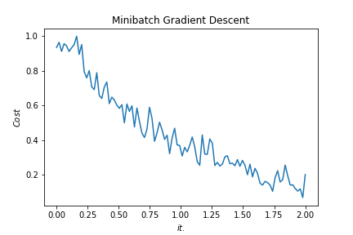
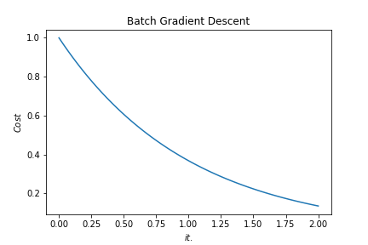
Batch vs. Mini-batch Gradient Descent
w2
w2
BGD
SGD
Batch Gradient Descent vs. SGD
SGD
w1
w1
Notes:
By @srvmshr
sourav@yahoo.com

Slide 71
x_{[1]}
p_{[1]}
x_{[2]}
p_{[2]}
x_{[3]}
Softmax Prediction with 2 outputs
Notes:
By @srvmshr
sourav@yahoo.com

Slide 72
Abstract backgrounds
Notes:
Note:
You can add abstract backgrounds here

Slide 73
Notes:
Note:
You can change the gradient of each component
Author: Elvis Saravia

Slide 74
dair.ai
Notes:
Note:
This is the header I use for the dair.ai NLP Newsletter
You can change the gradient of each component
You can customize the background as well by right clicking and changing to another gradient or static color
Author: Elvis Saravia

Slide 75
Notes:
Note:
This is the header I use for the dair.ai NLP Newsletter
You can change the gradient of each component
Author: Elvis Saravia

Slide 76
Notes:
Note:
This is the header I use for the dair.ai NLP Newsletter
You can change the gradient of each component
Author: Elvis Saravia

Slide 77
Gradient Backgrounds
Notes:
Note:
Gradient background shows some inspirations and ideas for color themes that could be used for backgrounds
The examples used in this section are inspired by https://uigradients.com

Slide 81
ML and Health

Slide 82
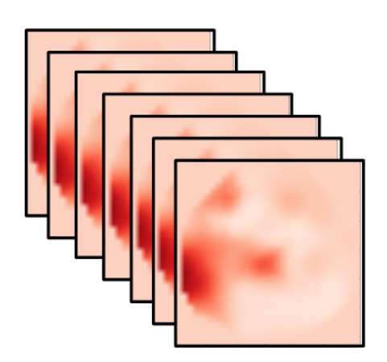
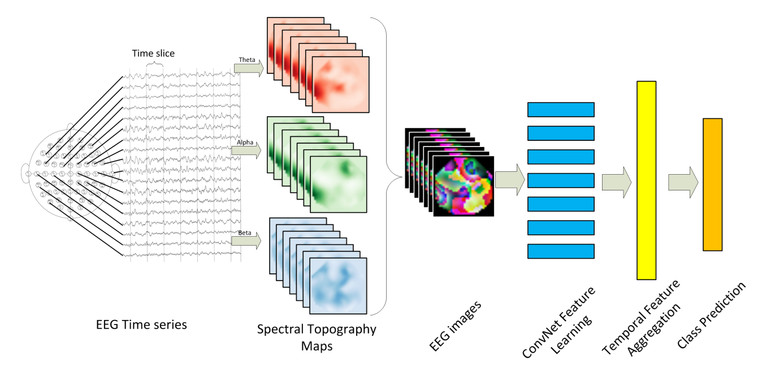
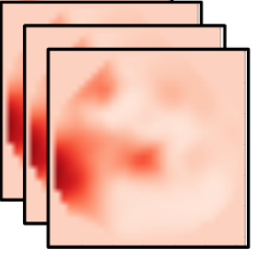
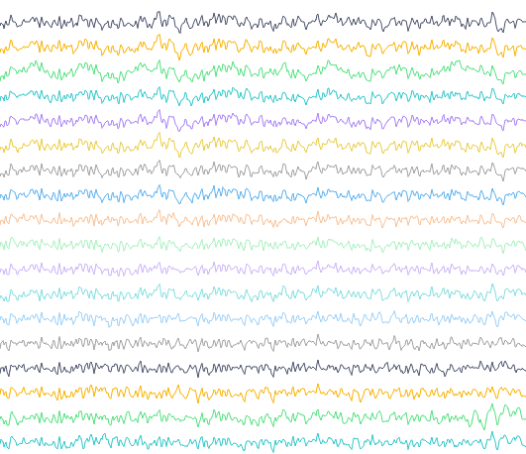
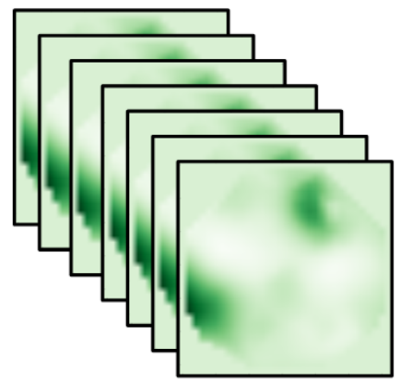
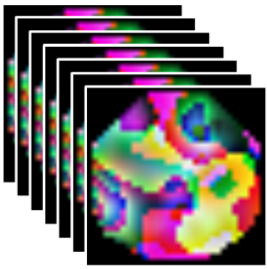
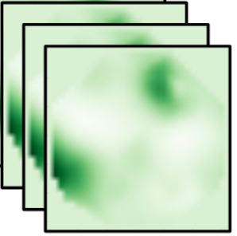
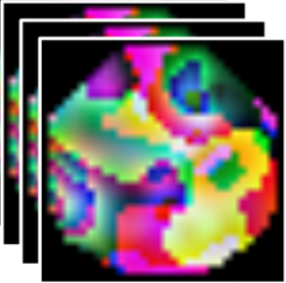
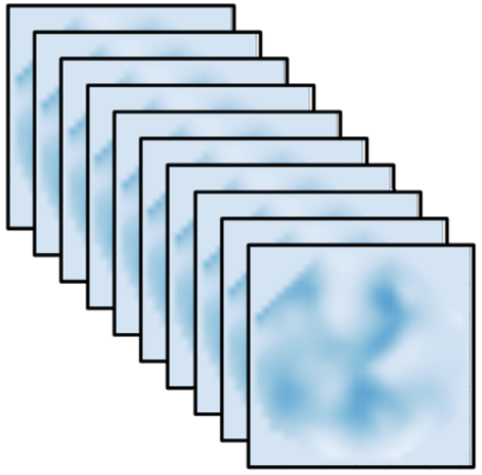
Time slice
Delta
Alpha
CNN
ICA
CNN
Conv
RNN+ANN
CNN
Conv
Alpha
CNN
Conv
CNN
Conv
CNN
Conv
CNN
Conv
Beta
CNN
Conv
CNN
CNN
Spatial Feature Learning
Temporal Feature Aggregation
Pain Intensity Assessment
Spectral Topography Maps
EEG Images
EEG Time Series
Notes:
Note:
These visuals can represent a multi-directional array (3D)
Author: Elvis Saravia (ellfae@gmail.com)

Slide 83
Time slice
Delta
Alpha
CNN
ICA
CNN
Conv
RNN+ANN
CNN
Conv
Alpha
CNN
Conv
CNN
Conv
CNN
Conv
CNN
Conv
Beta
CNN
Conv
CNN
CNN
Spatial Feature Learning
Temporal Feature Aggregation
Pain Intensity Assessment
Spectral Topography Maps
EEG Images
EEG Time Series
Notes:
Note:
These visuals can represent a multi-directional array (3D)
Author: Elvis Saravia (ellfae@gmail.com)

Slide 84
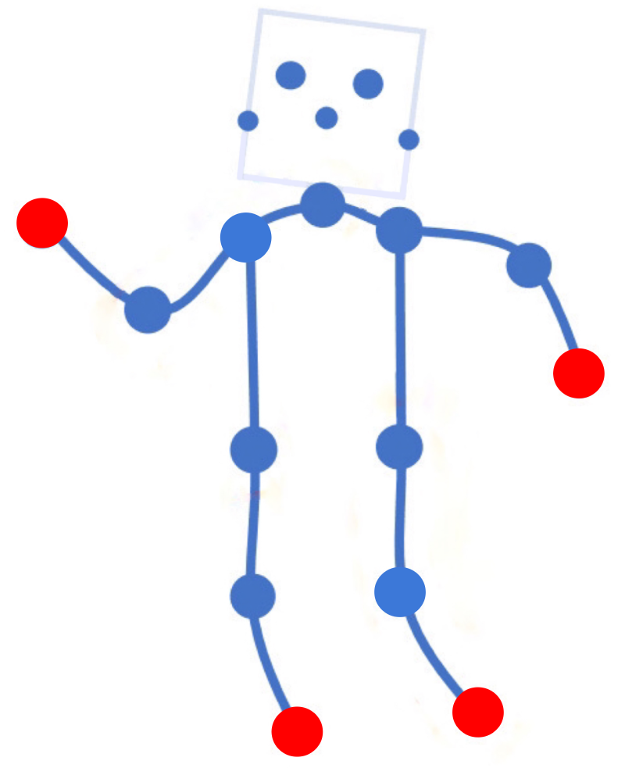
Time slice
Delta
No pain
Alpha
CNN
ICA
CNN
Conv
RNN+ANN
CNN
Conv
Alpha
CNN
Conv
CNN
Conv
CNN
Conv
CNN
Conv
Beta
CNN
Conv
CNN
CNN
Pain Intensity Assessment
Pain
Localization
Spatial Feature Learning
Temporal Feature Aggregation
Spectral Topography Maps
EEG Images
EEG Time Series
Notes:
Note:
These visuals can represent a multi-directional array (3D)
Author: Elvis Saravia (ellfae@gmail.com)

Slide 86
Time slice
Theta
Alpha
Conv
ICA
Conv
Conv
LSTM+AM
Conv
Conv
Alpha
Conv
Conv
Conv
Conv
Conv
Conv
Conv
Conv
Beta
Conv
Conv
Conv
Conv
EEG Time Series
Temporal Feature Aggregation
Pain Intensity Assessment
Pain Location Assessment
Spectral Topography Maps
EEG Images
Spatial Feature Learning
Notes:
Note:
These visuals can represent a multi-directional array (3D)
Author: Elvis Saravia (ellfae@gmail.com)

Slide 87
Conv
Conv
Conv
Conv
Conv
Conv
Conv
Conv
Conv
Conv

Slide 88
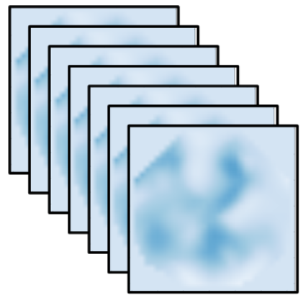


Slide 90
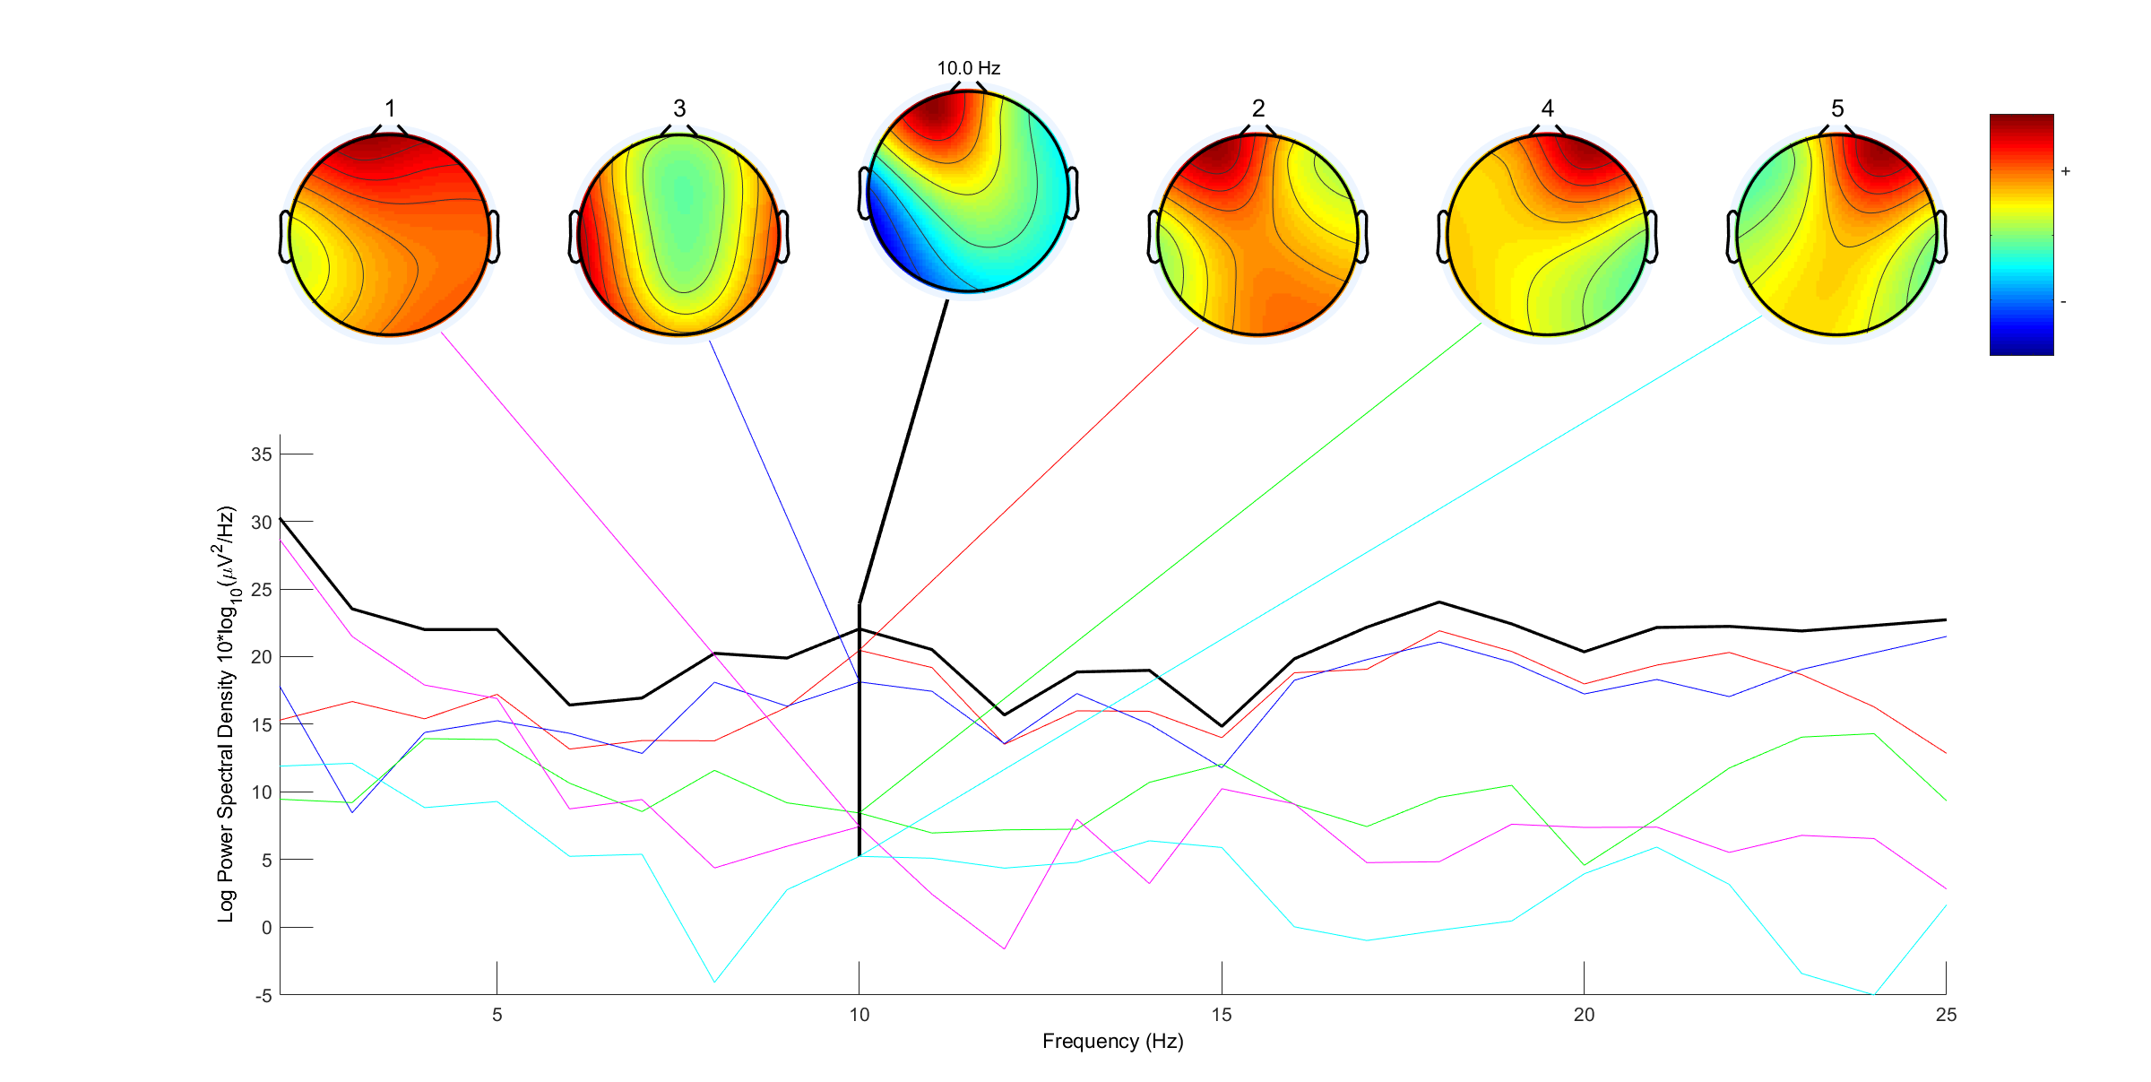

Slide 91
Withdraw
hand
Immerse
hand
Level 1
Level 2
Level 3
Level 4
No Pain
Low Pain
Moderate Pain
High Pain
Time
Signal Segmentation
Notes:
Note:
Can represent a multidimensional array (2D)
Author: Elvis Saravia (ellfae@gmail.com)

Slide 92
Level 1
Level 2
Level 3
Level 4
5s
Sliding Window
Event-Marker
…
No Pain
Low Pain
Medium Pain
High Pain
Time
Immerse
hand
Withdraw
hand
Notes:
Note:
Can represent a multidimensional array (2D)
Author: Elvis Saravia (ellfae@gmail.com)

Slide 93
Level 1
Level 2
Level 3
Level 4
No Pain
Low Pain
Medium Pain
High Pain
Time
Immerse
hand
Withdraw
hand
Notes:
Note:
Can represent a multidimensional array (2D)
Author: Elvis Saravia (ellfae@gmail.com)

Slide 94
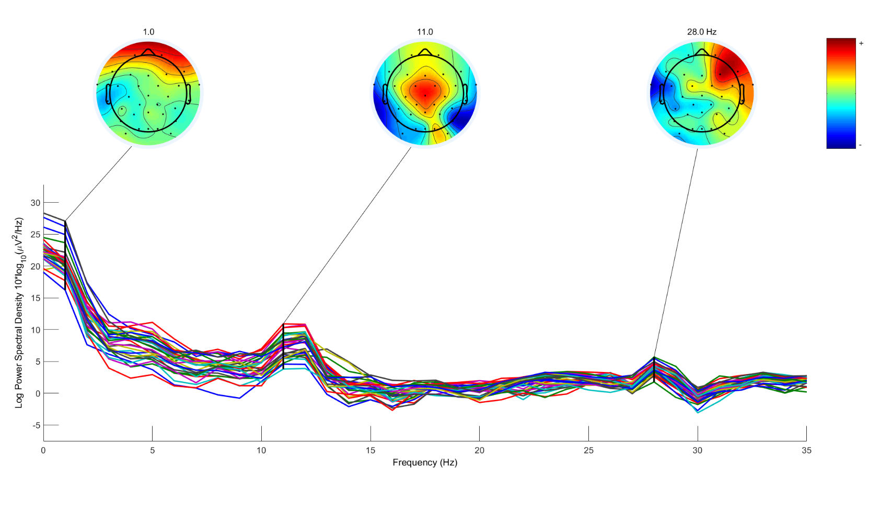

Slide 95
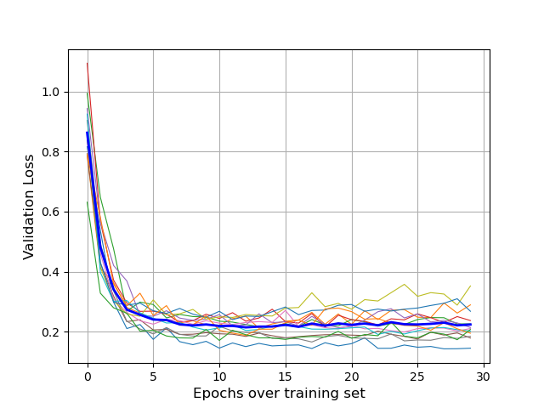
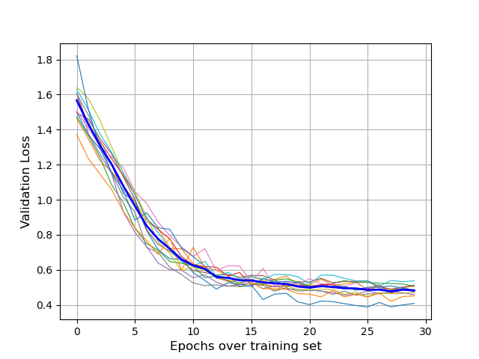
(a)
(b)

Slide 96
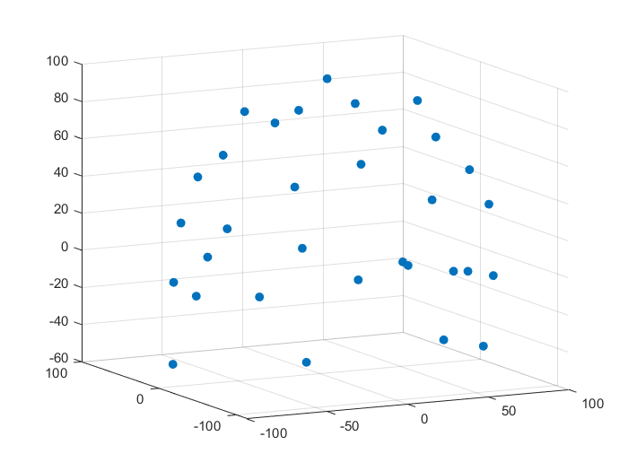
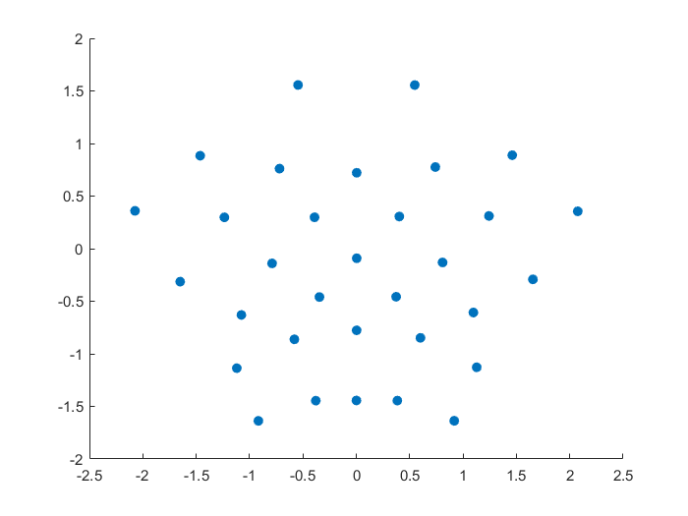
AEP

Slide 97
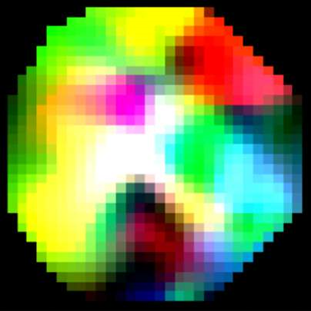
AEP
Bicubic
Delta
Alpha
Beta
FFT
EEG Image

Slide 98


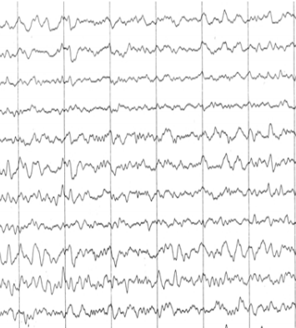
AEP
Bicubic
PSD
Theta(4~8Hz)
Alpha(8~13Hz)
Beta(13~30Hz)
FFT
Spectral Topography Map
Image Generation

Slide 99
Input
Conv3-32
x4
Maxpool
(2x2)
Conv3-64
x2
32x32x3
Maxpool
(2x2)
Conv3-
128
Maxpool
(2x2)
Output
FC-512
Feature
Vector
ConvNet Configuration
Notes:
Note:
These visuals can represent a multi-directional array (3D)
Author: Elvis Saravia (ellfae@gmail.com)

Slide 100
Layer1
Layer2
Layer3
Layer1
Layer2
Layer3
Layer4
Input
Output
Conv3-32
Conv3-32
Conv3-32
Conv3-32
Max-Pool
Conv3-64
Max-Pool
Conv3-128
Max-Pool
Conv3-64
FC-512
Input
Conv
Max-Pool
Conv
Max-Pool
FC
FC
Softmax
ConvNet Configuration
Stack1
Stack2
Stack3
Stack4
Conv3-32
Output
Conv3-32
Conv3-32
Conv3-32
Max-Pool
Conv3-64
Max-Pool
Conv3-128
Max-Pool
Conv3-64
FC-512
Notes:
By @avsthiago

Slide 101
Stack1
Stack2
Stack3
Stack4
Conv3-32
Conv3-32
Max-Pool
Output
Conv3-64
Max-Pool
Conv3-128
Max-Pool
Conv3-64
FC-512
Conv3-32
Conv3-32

Slide 102
Time
Unbearable
Pain
Level 5
Level 4
High
Pain
MediumPain
Level 3
Level 2
LowPain
Level 1
No Pain
(a)
(b)

Slide 103
Level 1
Level 2
Level 3
Level 4
Level 5
Time
No Pain
LowPain
MediumPain
High
Pain
Unbearable
Pain
(a)
(b)

Slide 104
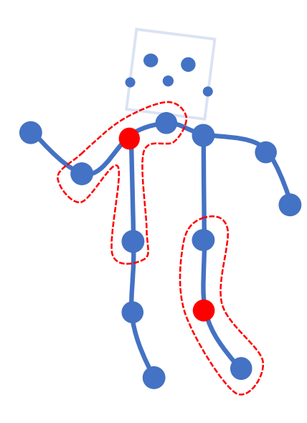
Notes:
Note:
Can represent a multidimensional array (2D)
Author: Elvis Saravia (ellfae@gmail.com)

Slide 105
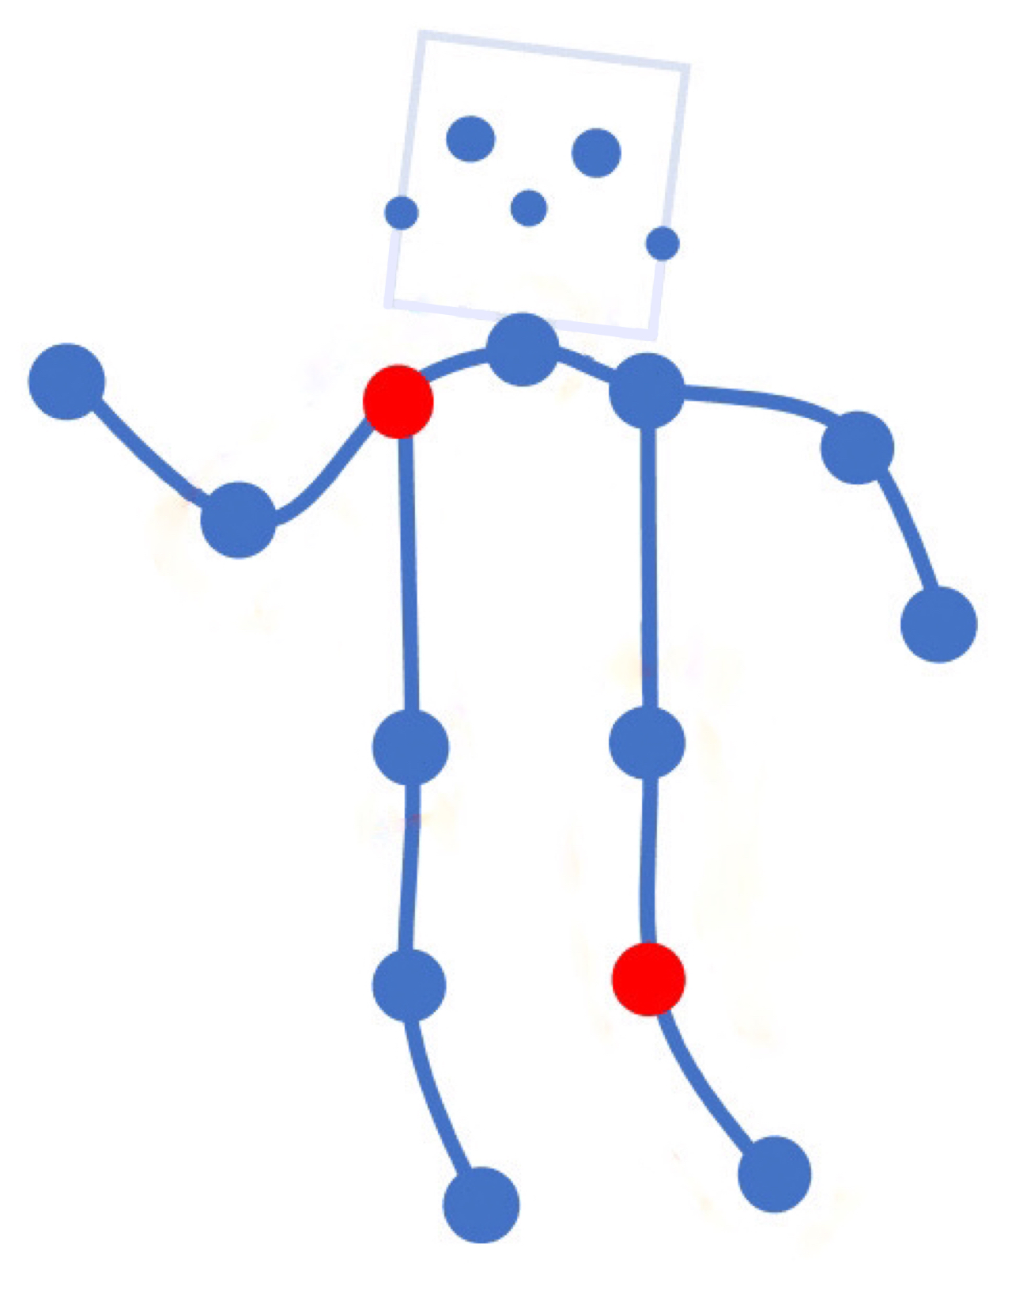

Notes:
Note:
Can represent a multidimensional array (2D)
Author: Elvis Saravia (ellfae@gmail.com)

Slide 106
Miscellaneous

Slide 107
16
16+32
16
16
1
3
Convolution 3x3
Convolution 1x1
Dropout 0.1
16
Max Pooling 2x2
Skip connection
Dropout 0.2
Up Sampling 2x2
Block copied
Dropout 0.3
32
32
32+64
32
64
64
64+128
64
128
128
128+256
128
256
256
Notes:
By @avsthiago

Slide 108
Layer1
Layer2
Layer3
Layer1
Layer2
Layer3
Layer4
Input
Output
Conv3-32
Conv3-32
Conv3-32
Conv3-32
Max-Pool
Conv3-64
Max-Pool
Conv3-128
Max-Pool
Conv3-64
FC-512
Input
Conv
Max-Pool
Conv
Max-Pool
FC
FC
Softmax
Layer1
Layer2
Layer3
Layer4
Conv3-32
Output
Feature
Vector
Conv3-32
Conv3-32
Conv3-32
Max-Pool
Conv3-64
Max-Pool
Conv3-128
Max-Pool
Conv3-64
FC-512
Notes:
By @avsthiago

Slide 109
Filter concatenation
3x3 convolutions
5x5 convolutions
1x1 convolutions
1x1 convolutions
1x1 convolutions
1x1 convolutions
3x3 max pooling
Previous layer
Notes:
By @avsthiago

Slide 110
Filter concatenation
3x3 convolutions
5x5 convolutions
1x1 convolutions
1x1 convolutions
1x1 convolutions
1x1 convolutions
3x3 max pooling
Previous layer
Notes:
By @avsthiago

Slide 111
Output
Inception 2
Inception 2
Inception 2
Inception 1
FC
FC
1x7 conv
1x7 conv
1x11 conv
1x11 conv
Input

Slide 112
Previous layer
1x3 conv,
1 padding
1x3 conv,
1 padding
1x7 conv,
3 padding
1x3 conv,
1 padding
1x5 conv,
2 padding
1x3 conv,
1 padding
Filter concatenation

Slide 113
Avg-Pool
Auxiliary Classifier
Conv
FC
FC
Softmax
Inception
Input
Inception
Conv
Max-Pool
Conv
Max-Pool
Conv
Max-Pool
Inception
Inception
Max-Pool
Inception
Inception
Inception
Inception
Inception
Max-Pool
Avg-Pool
Conv
FC
Softmax
Avg-Pool
Auxiliary Classifier
Conv
FC
FC
Softmax
Notes:
By @avsthiago

Slide 114
Filter concatenation
Filter concatenation
3x3 conv.
1x3 conv.
3x1 conv.
1x1 conv.
3x3 conv.
3x3 conv.
1x1 conv.
1x3 conv.
3x1 conv.
3x3 conv.
1x1 conv.
1x1 conv.
Pool
1x1 conv.
1x1 conv.
Pool
1x1 conv.
1x1 conv.
Previous layer
Previous layer
(a)
(b)
Notes:
By @avsthiago

Slide 115
Previous input
Previous input
x
x
F(x)
F(x)
Stacked layers
Stacked layers
x
identity
+
y=F(x)
y=F(x)+x
R1
R1
R2
R1
R1
R2
R3
R1
R2
R3
Notes:
By @avsthiago

Slide 116
Dense Block 1
Dense Block 2
Dense Block 3
Softmax
FC
Avg-Pool
Avg-Pool
Conv
Conv
Input
Avg-Pool
Conv
Transition layers
Notes:
By @avsthiago

Slide 117

h_{i+1}
Filter concatenation
h_{i+1}
add
add
Filter concatenation
3x3 max
3x3 conv
3x3 avg
identity
add
add
add
add
add
add
add
add
3x3 conv
identity
3x3 conv
5x5 conv
3x3 avg
identity
3x3 avg
3x3 avg
3x3 conv
5x5 conv
7x7 conv
5x5 conv
3x3 max
7x7 conv
3x3 avg
5x5 conv
h_{i}
h_{i}
...
...
h_{i-1}
h_{i-1}
(a)
(b)
Notes:
By @avsthiago

Slide 118
Notes:
By @avsthiago

Slide 119
Notes:
By @avsthiago
Dark-theme version of the previous (by Elvis Saravia)

Slide 120
Max(1,1,5,6) = 6
Y
1
1
2
4
5
6
7
8
6
8
3
2
1
0
Pooling performed with a 2x2 kernel and a stride of 2
3
4
1
2
3
4
X
Image Representation
Notes:
By @avsthiago

Slide 121
ML System Design / Infrastructure

Slide 122
APP
疼痛等级
治疗力度
EEG
疼痛识别
疼痛治疗仪
疼痛位置
治疗方案
使用者的治疗时长、治疗方案、治疗反馈记录
Notes:
Note:
Can represent a multidimensional array (2D)
Author: Elvis Saravia (ellfae@gmail.com)

Slide 123

Closed-loop Control
Pain Recognition
APP
疼痛强度
Deep
Learning
Page Design
EEG
Pain Localization
Data
Mining
Reinforce
Learning
治疗反馈
脑电检测
治疗方案
治疗力度
Pain Treatment Apparatus
Pain Management
Appearance
Design
Circuit
Design

Slide 124
APP
页面设计
数据挖掘
强化学习
主观疼痛感受
普通用户
治疗反馈
治疗方案
治疗力度
疼痛治疗
疼痛治疗仪
外观设计
电路设计

Slide 125

疼痛识别
APP
疼痛强度
深度学习
页面设计
EEG
疼痛定位
数据挖掘
强化学习
特殊患者
脑电监测
脑电信号
采集/反馈
治疗方案
治疗力度
疼痛治疗仪
疼痛治疗
外观设计
电路设计

Slide 126
应用场景
普通患者：能够自己感觉到疼痛并报告出来。
对于该类患者可以脱离脑电波头盔而单独存在，用户根据自身感觉，使用该疼痛治疗仪和app，将tens片放置疼痛源部位，可自行选择不同的治疗模式或使用我们的智能推荐模式进行治疗，有效地减缓疼痛。在该应用场景下，我们的产品依赖于人体的主观感觉和反馈，在强化学习和数据挖掘的基础上进行智能治疗。
优点：使用范围广，成本低，无创伤，智能治疗
特殊患者：无法感觉疼痛或无法报告出来，如老年痴呆症患者，婴幼儿，手术前/后，或处于昏迷状态的患者。
对于该类患者，我们引入了脑机接口技术，通过检测患者的脑电活动，识别出疼痛强度和疼痛位置，将信息传至app端，便可根据该结果进行准确治疗。治疗过程中，患者脑电波能够做出一定的反馈，根据该反馈进行强化学习不断调整治疗参数，以达到有效且精确的治疗。
优点：更为客观的基于脑电波的疼痛识别，较高的临床价值，无创伤，智能治疗
缺点：脑电头盔成本高，使用范围较为局限
脑电监测：仅需监控，无需治疗，可使用我们的疼痛识别算法系统（软件），可应用于手术中患者的疼痛监测等。

Slide 127


不同场景—— 痛经治疗仪

Slide 129


Slide 130
疼痛识别
APP
疼痛强度
深度学习
页面
设计
EEG
疼痛定位
数据挖掘
强化学习
特殊患者
脑电信号
采集/反馈
主观疼痛感受
治疗方案
治疗力度
治疗反馈
疼痛治疗仪
疼痛治疗
外观设计
电路设计

Slide 131





Slide 132


Slide 133

TL | Dataset | Signal | Paradigm | Sfreq. Hz | Channels | Subjects | Samples | Targets
Pre-training | WM | EEG | WM | 500 | 64 | 13 | 2670 | 4
Downstream | Pain | EEG | CPT | 128 | 32 | 15 | 1181 | 4

